Slide 1
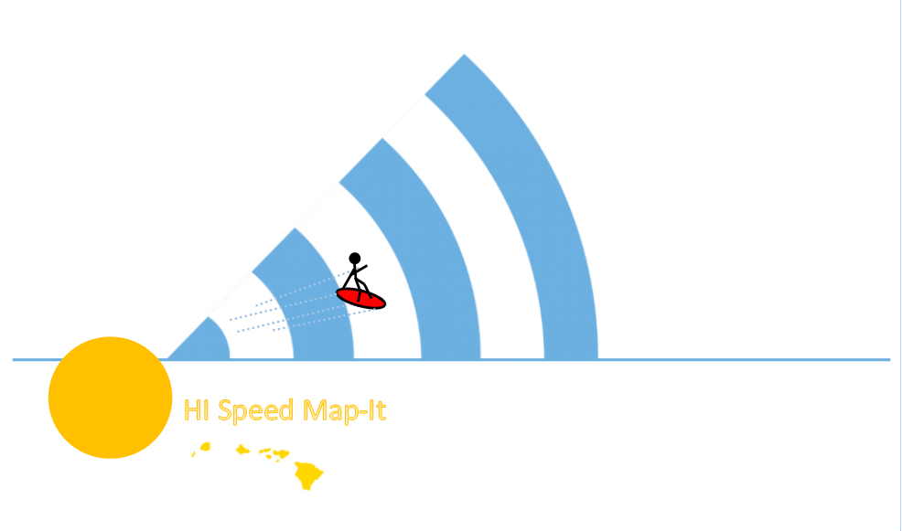
State of Hawaii Department of Commerce and Consumer Affairs Cable Television Division Hawaii Annual Code Challenge 2017

Slide 2



Remember this?
₊

Slide 3

For some, this happens…
and for others still…

Slide 4
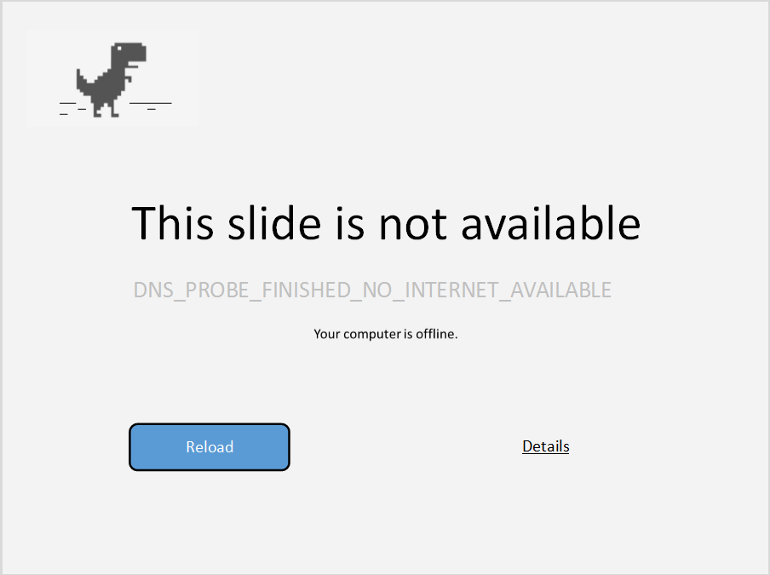
Your computer is offline.

Slide 5
















No access to internet is not
only …
Education
Jobs
Health & Safety
…it can also mean

Slide 6

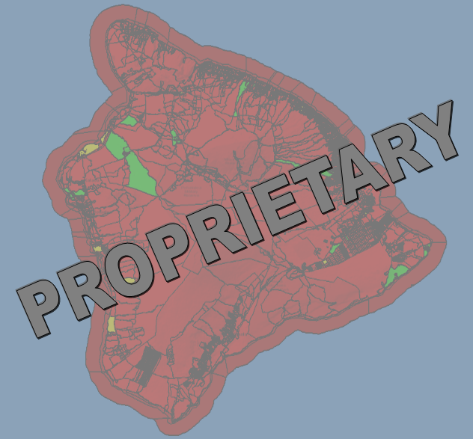
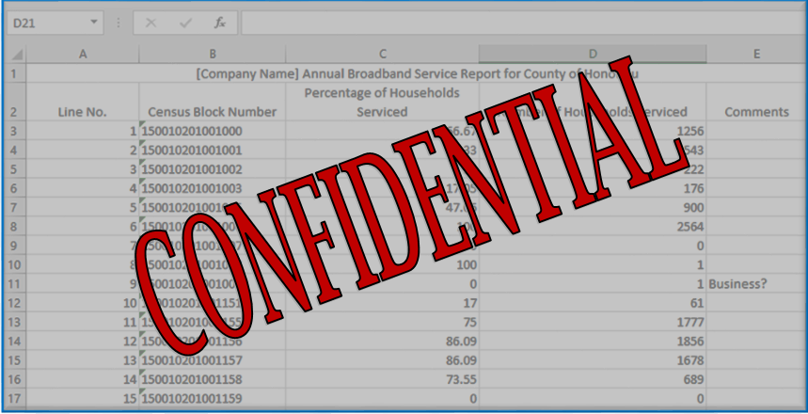
What resources are available to address broadband issues?

Slide 7
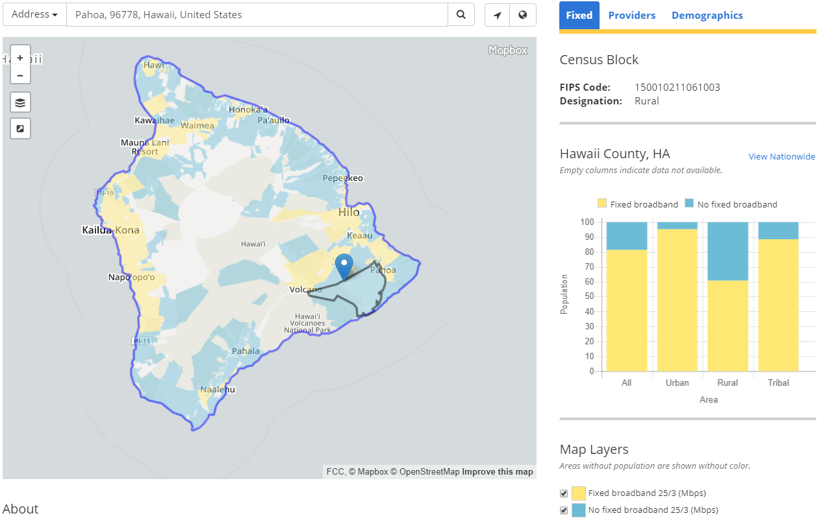
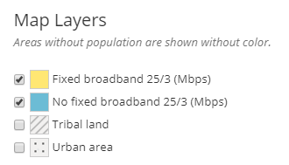

The Map We Have Now:
FCC Fixed Broadband Deployment Map (June, 2016)

Slide 8
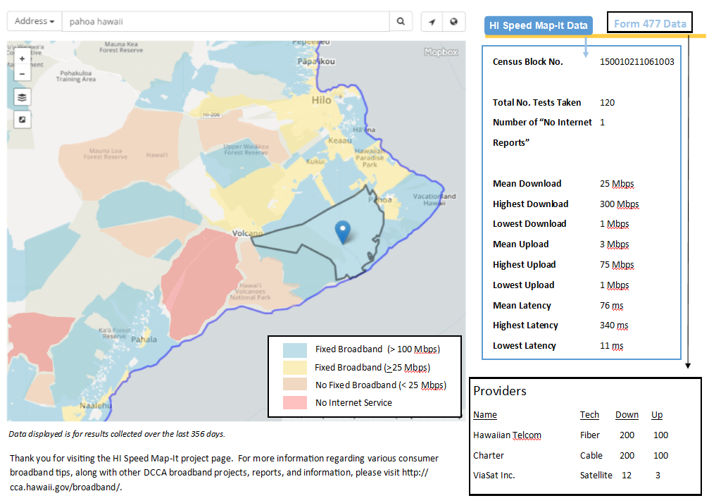
The Map We Want:
Aggregated User test results
FCC map layer with list of providers in their area
More information than just fixed broadband or no fixed broadband, and advertised speeds, for a census block

Slide 9

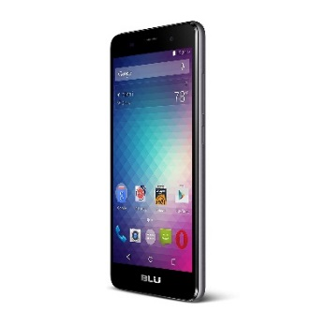



What we Need from YOU:
An enticing, easy to use app (both wireline and mobile versions) to:
Encourage EVERYONE to participate in broadband data collection
Allow residents to report locations of “No Internet” access
Gather better data through self-reported speed test results by participants anywhere in the State
Share a MAP of the data on an ongoing basis to track broadband metrics in our State.

Slide 10



Who Will Benefit From HI Speed Map-It?
Policymakers
Providers
The Public

Slide 11

The Goal – Internet Speeds Like this…

Slide 12

…and NOT like this

Slide 13




We showed you what we came up with…but can YOU do better?

Slide 14
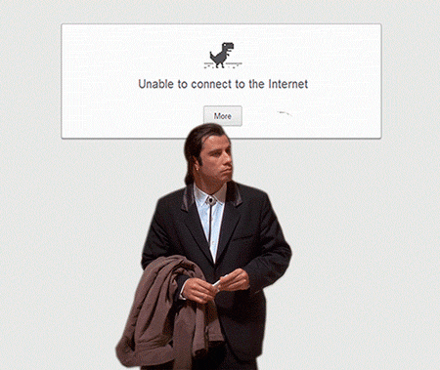
Please Help!
State of Hawaii Department of Commerce and Consumer Affairs Cable Television Division Hawaii Annual Code Challenge 2017
Thank You!

